Slide 1


Project of Application for Piano Music Generation by Artificial Intelligence Algorithms
07 February 2023
Authors:
Weronika Piotrowska, Szymon Górski, Marcin Wojnarowski
Thesis Supervisor:
dr hab. inż. Jerzy Balicki, prof. uczelni
Notes:
We would like to present our bachelor’s diploma thesis project created in this group of three (me, Weronika, and Marcin), under the supervision of professor Balicki, named “Project of Application for Piano Music Generation by Artificial Intelligence Algorithms”.

Slide 2
Agenda
Introduction
Used dataset
Used models
Results
Demonstration
Conclusions
Future work
Scope of work
Notes:
During the speech we are going to present data and models used in our application, results we obtained as well as show a short demonstration of the application at work. Then we will summarize the project.

Slide 3
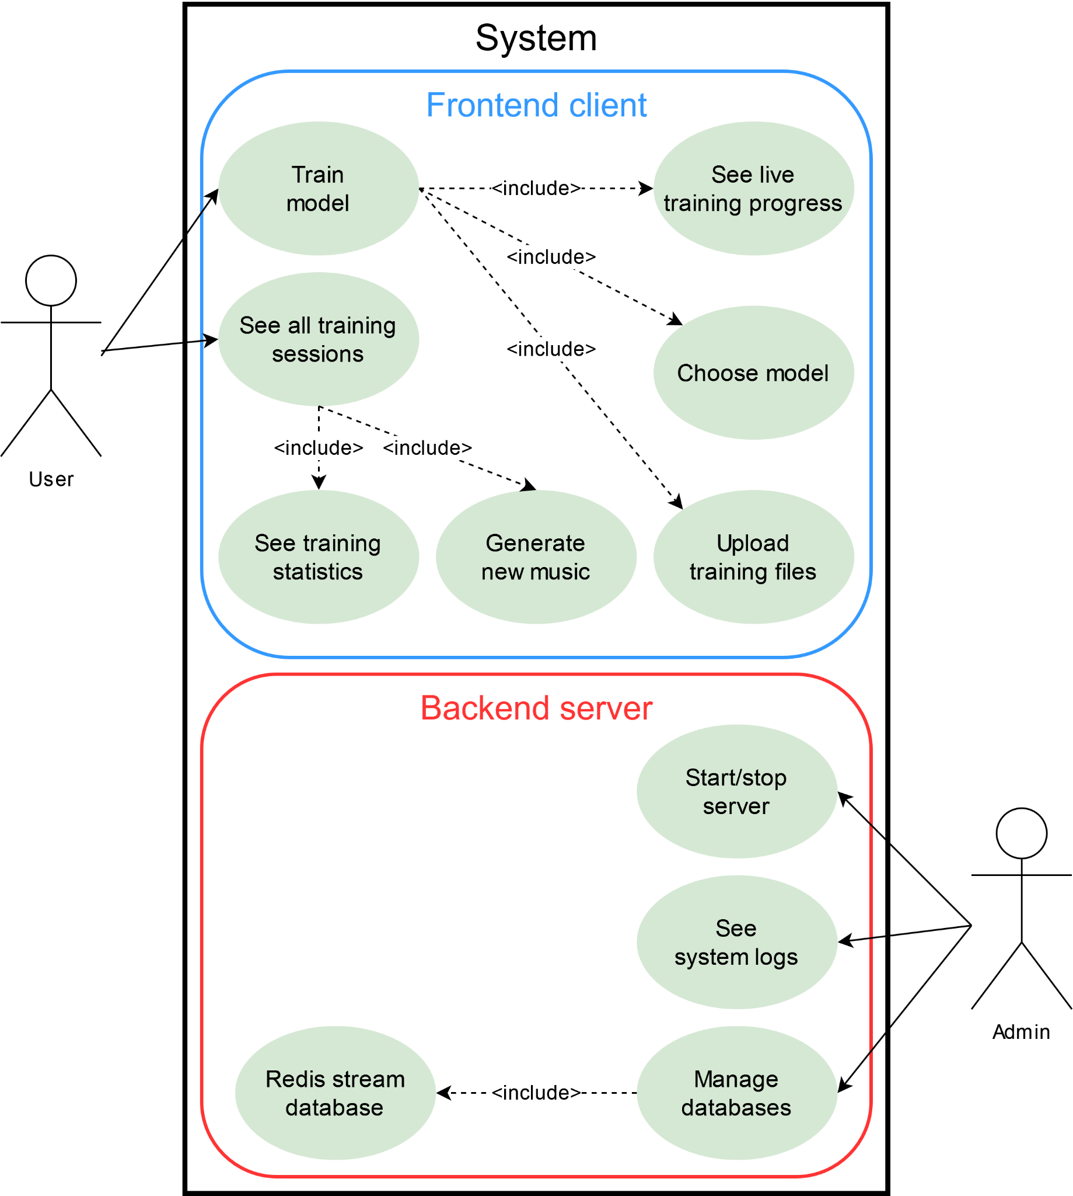
Introduction
Our aims:
Generate music with AI
Compare qualities of different models
Wrap it in a nice application
Notes:
The main goal of the project was to build software which generates music using AI algorithms. We wrapped these algorithms in an application which allows users to smoothly train models, generate music and trace results via the GUI.

Slide 4
Dataset
Important dataset characteristics:
All data is compositions for a single instrument type (the piano) by a prolific, popular author (Johann Sebastian Bach) to enhance pattern recognition
MIDI files to provide lossless and efficient music notation
184 high-quality polyphonic MIDI files with 154 compositions
MIDI File (format 1)
metadata + tracks:
…
Track 0
Tempo
metadata + messages:
- tempo
- (time)
Track 1
Instrument
metadata + messages:
- note on/off
- height
- velocity
- (time)
Track N
Instrument
metadata + messages:
- note on/off
- height
- velocity
- (time)
Notes:
In order to begin training, we must have delivered music samples to our models. We decided to select compositions for a single type of instrument (the piano) by one author (Johann Bach) to enhance pattern recognition. We collected 184 MIDI files as a mean of lossless and efficient transcription of music notation.

Slide 5
MIDI files
Important observations regarding architecture:
MIDI binary messages should be translated into objects
Sequences of notes should be presented in normalized intervals
Final data representation should be customized per model to address its possibilities and limitations
The decoding flow:
.mid file
combining tracks
normalizing
output array
inserting booleans
.npy file
selecting all notes
cleaning tracks
list of events
output list
inserting velocities
selecting active notes
Notes:
We put a significant effort into translating these files into numeric matrices, understood by models. The main steps included objectification of binary messages, normalization and presentation in forms adapted for each model. To achieve this, we built a custom decoder and encoder which can inter alia clean and combine tracks, provide evenly distributed arrays or lists of events.

Slide 6
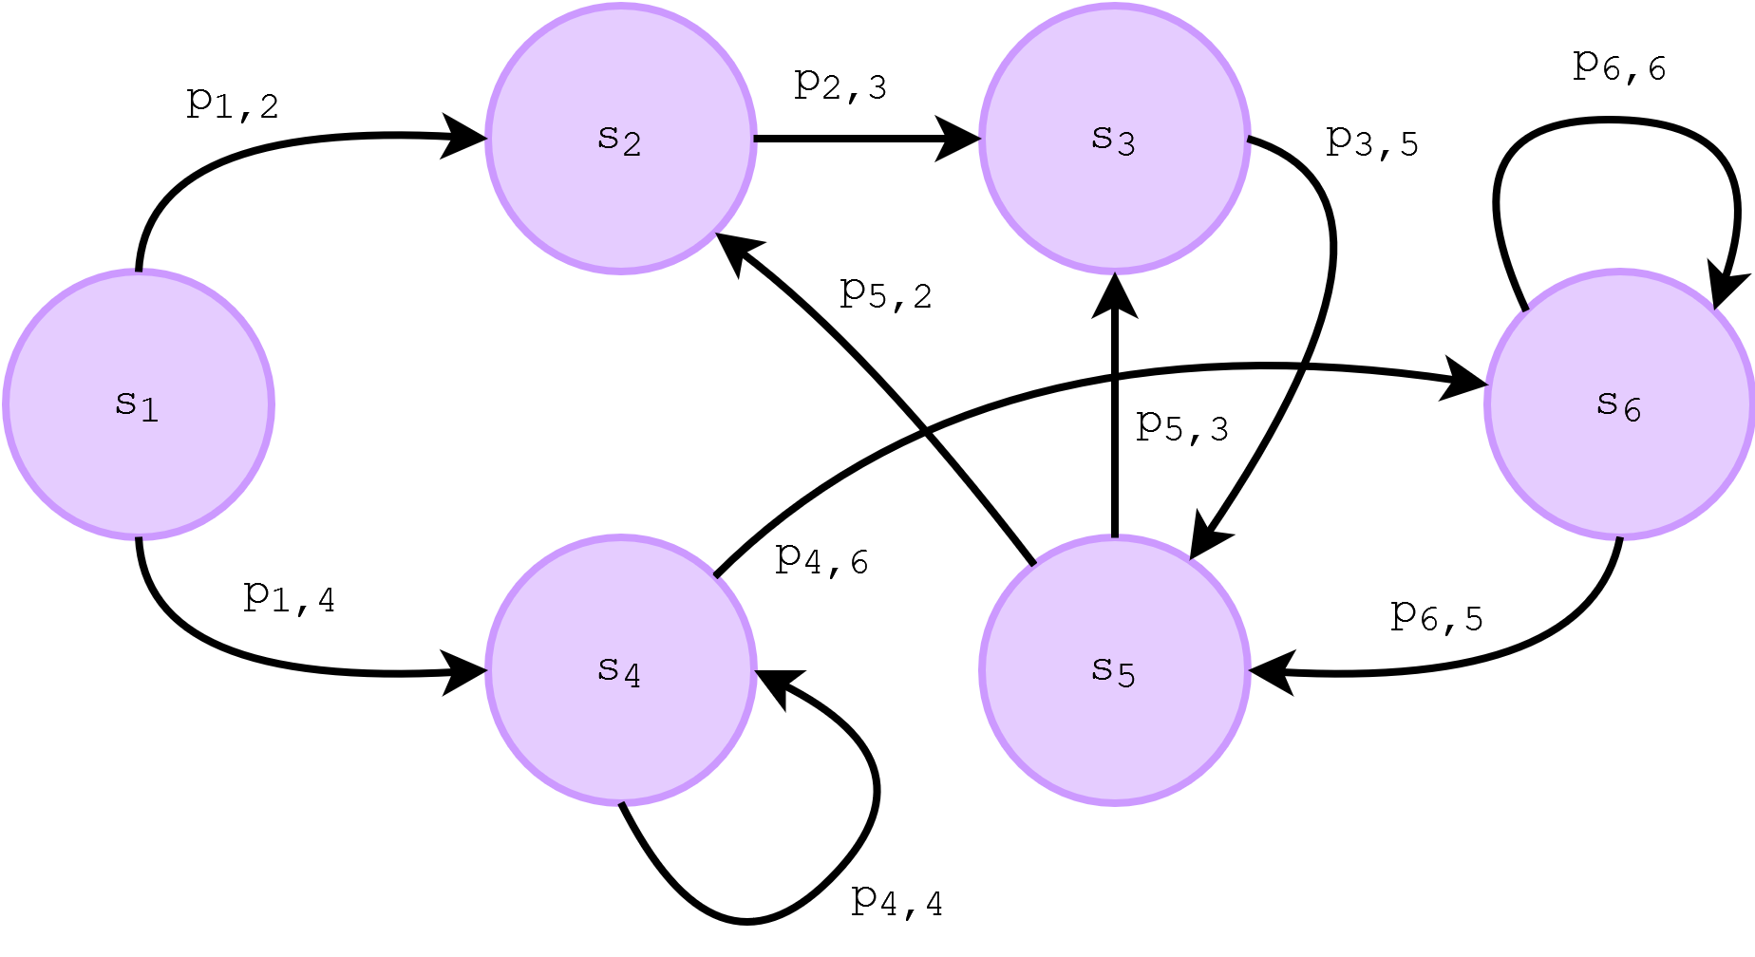
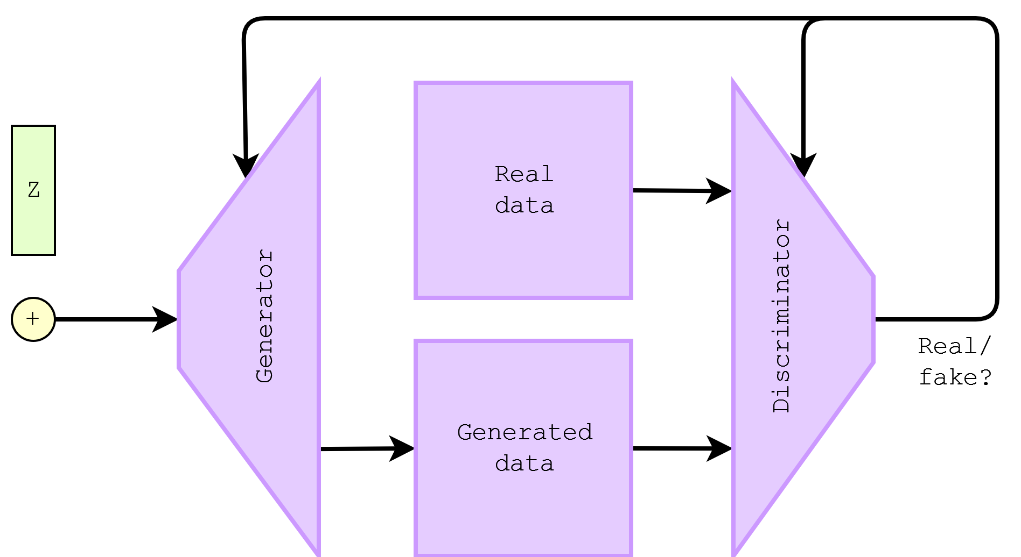
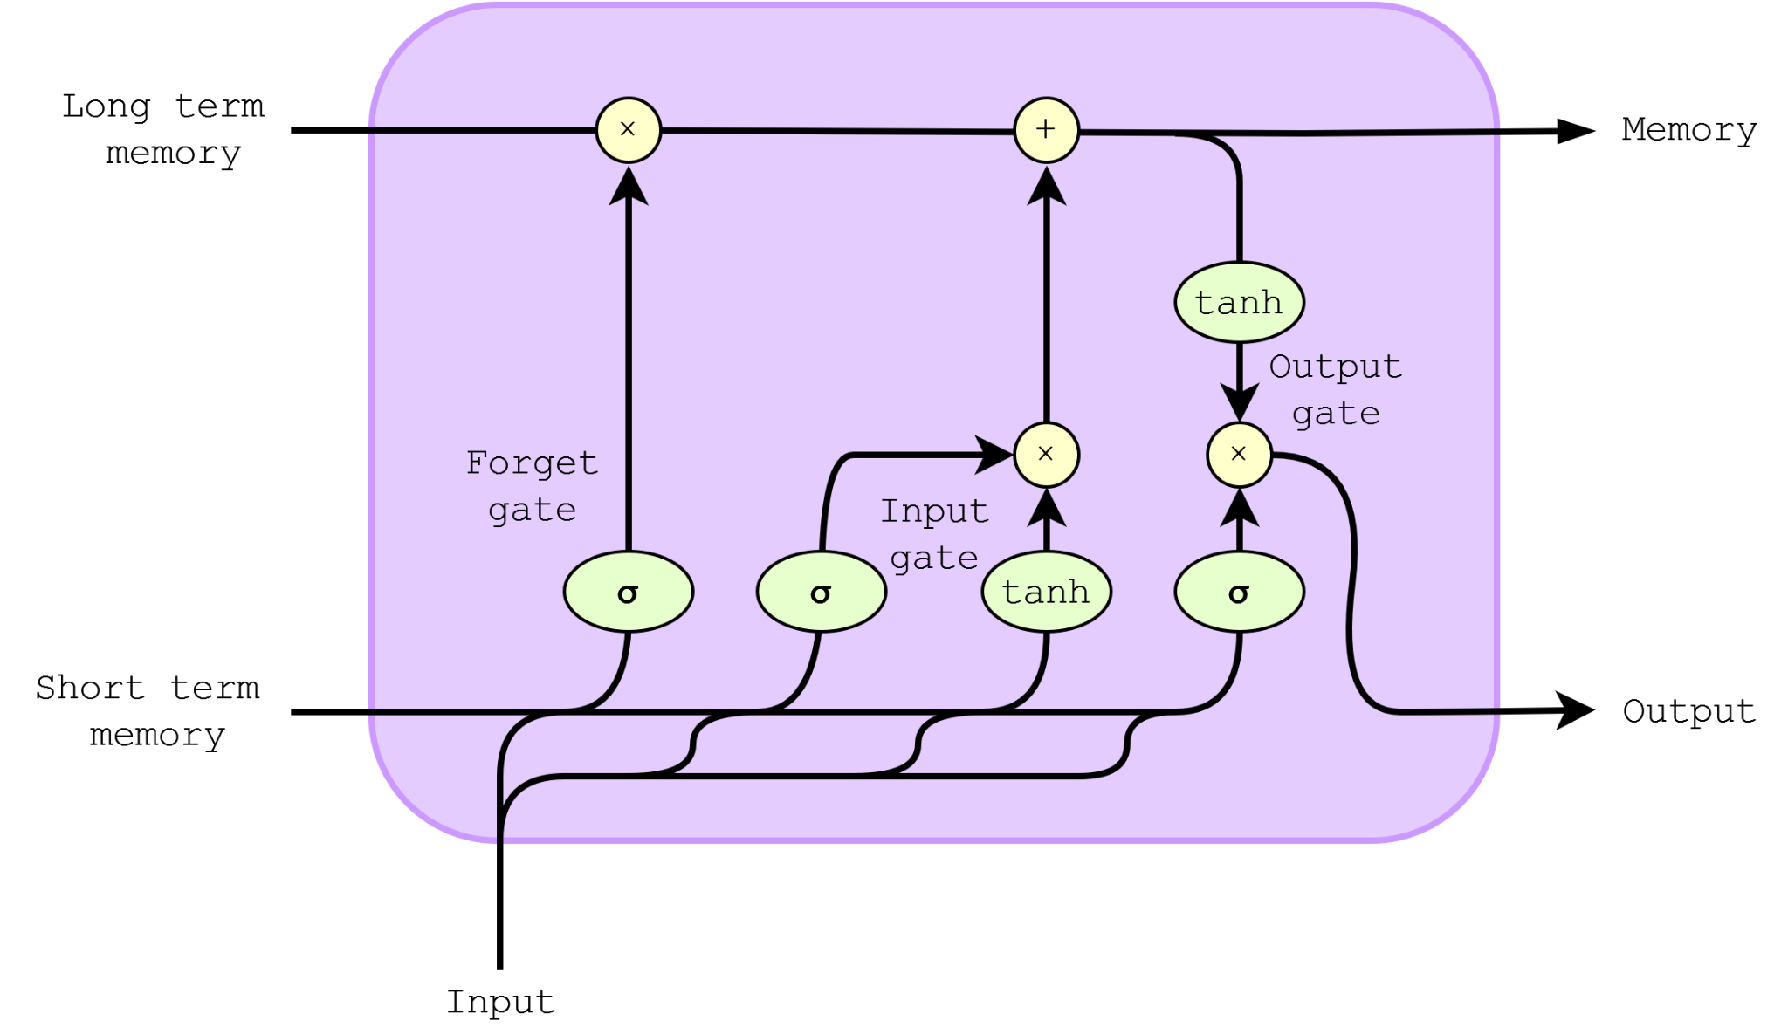
Used models
Model unit schemas
1. Markov Chain
2. GAN
3. LSTM
Markov Chain
Generative Adversarial Network (GAN)
Long Short-Term Memory (LSTM)
Notes:
Proponuje to zamiast następnych slajdów o modelach /W
Tu wypada powiedzieć, że Markov jest niegodny ewaluacji (żeby nie było, że go olaliśmy) /SZ

Slide 7
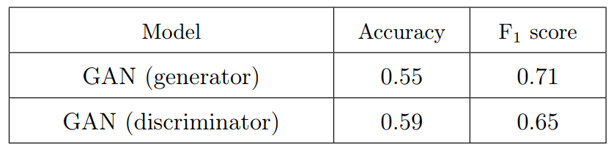
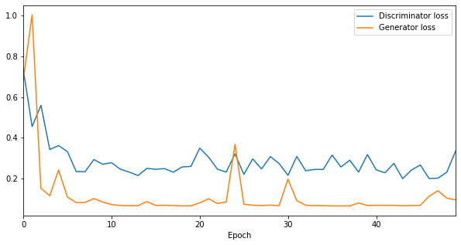
Results (GAN)
GAN accuracy
Accuracy

Slide 8
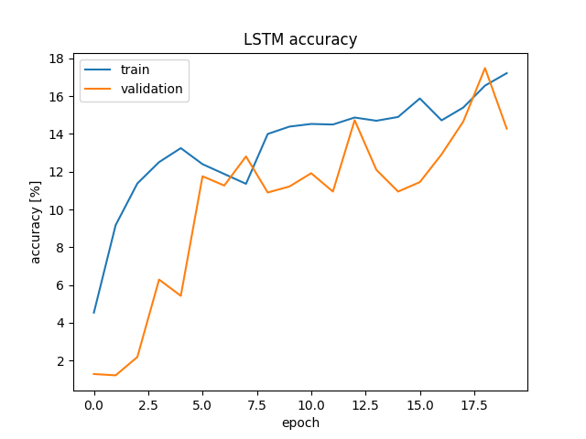
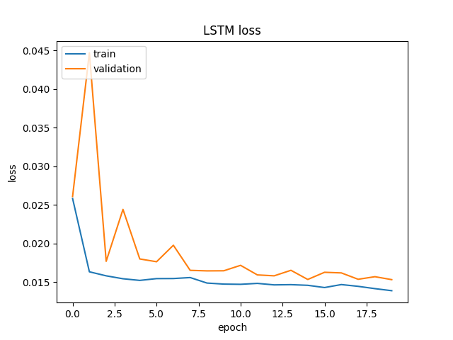
Results (LSTM)

Slide 9
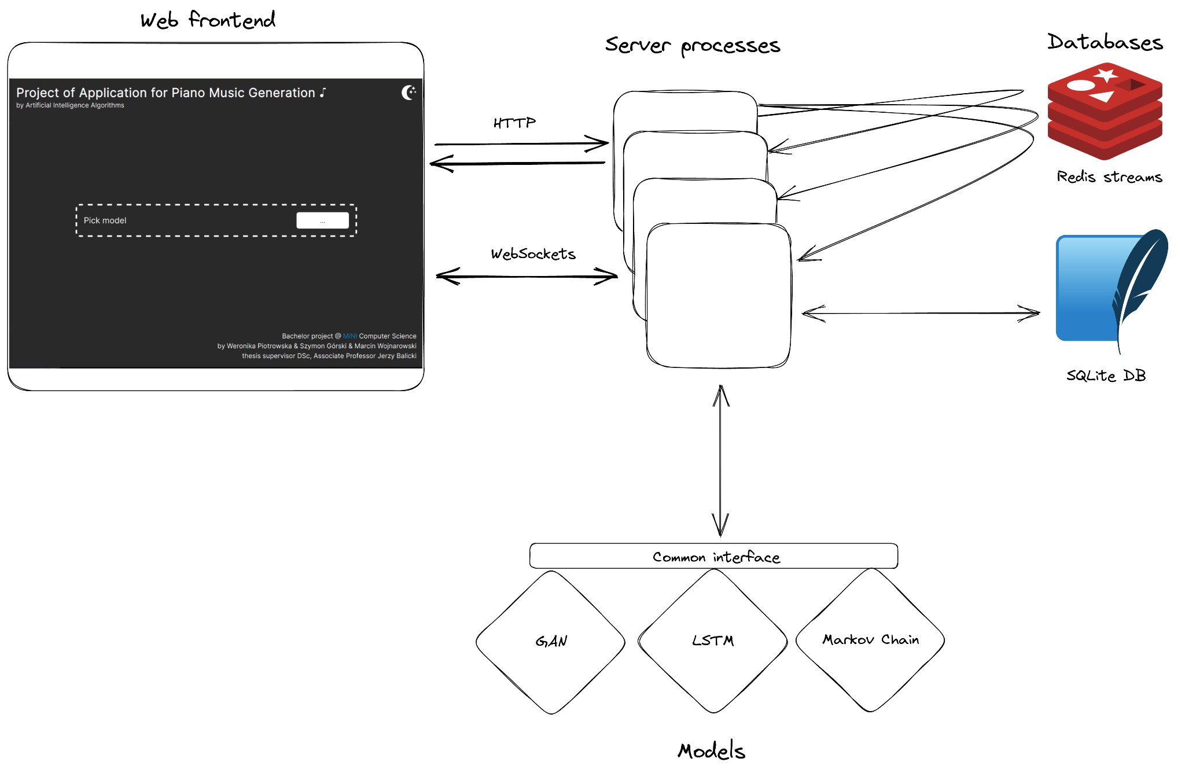
Application architecture
Notes:
Users can pick one of the implemented models
Users can train themselves or use a pre-trained model
Users can generate music given some seed
The app is accessible online for anyone to use
Takes instructions from the user interface and communicates with prepared models
Streams training progress to the frontend
Generates MIDI files for the frontend to download

Slide 10
Application demonstration

Slide 11
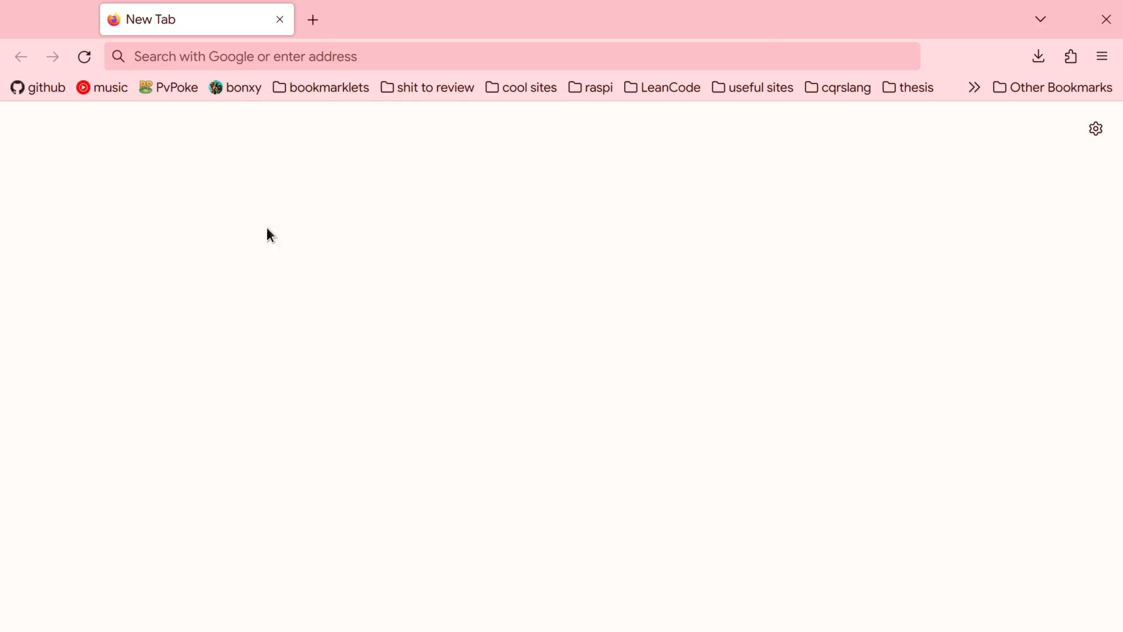
Notes:
This slide must be skipped by the arrow in the presenter mode.

Slide 12
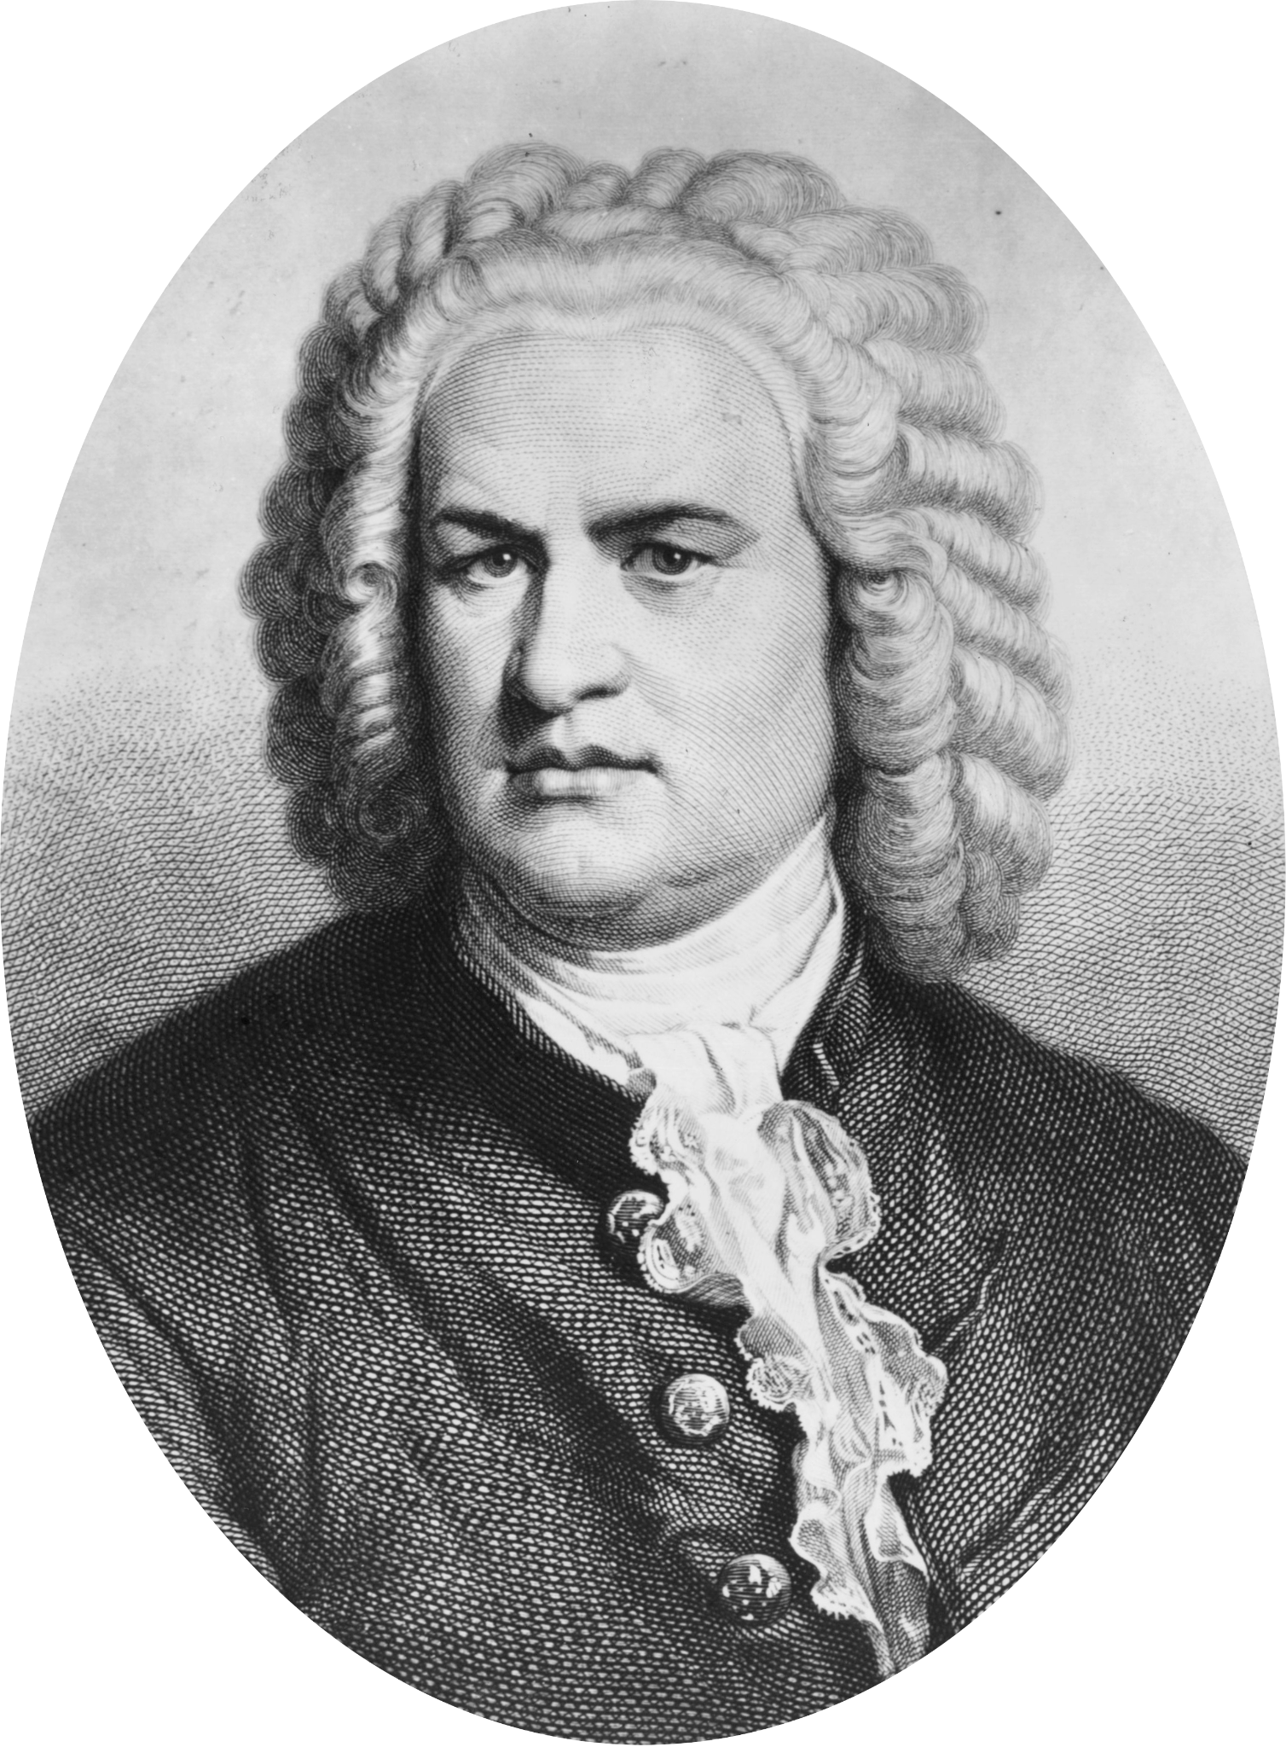

Audio demonstration
source: commons.wikimedia.org/wiki/File:BACH_Portrait.jpg, CC-BY-SA-4.0, unknown author (file modified)
Notes:
This slide must be skipped by the arrow in the presenter mode.

Slide 13
Remarks and Conclusions
The project required knowledge about MIDI, generative models, and application development
It is possible to generate music with mentioned models
All models yield satisfactory results but due to their differing nature comparison is only subjective
GANs and LSTMs are ANN, while Markov Chain is a purely statistical method
Application is agnostic to the underlying models

Slide 14
Future work
Support of model configuration through the user interface
Implementation of additional, more advanced models
Acceptance of different audio formats
Support of different instruments

Slide 15
Division and scope of work
Author | Tasks
Collective tasks | Project preparation Research of available datasets Unit testing Integration testing System testing Final corrections and system review
Szymon Górski | Choice of datasets to be included and accessing them Implementation of MIDI transcription module LSTM model development
Weronika Piotrowska | GAN model development Markov Chains model development Efficiency and quality comparison of AI models
Marcin Wojnarowski | Client-server application establishment Graphic User Interface design and implementation Application integration with all AI models LSTM model development
Notes:
To achieve the goals of the project within a time limit, we distributed some tasks among us to be executed in parallel. We have done initial research and testing together. I selected data, implemented tools for MIDI translation and developed the LSTM model. Weronika developed GANs, Markov chains and prepared the evaluation of models. Marcin created frontend with GUI and developed the LSTM model as well.

Slide 16
Thank you for your attention

